Slide 1


Preparing your Organization to Work in Solidarity towards Wabanaki Land Relationship
First Light self-guided curriculum

Slide 2
Welcome to the course!
We are Ella McDonald and Ellie Oldach, two non-native former/current staff with First Light, and the designers of this self-guided curriculum. We offer this living curriculum to landholding entities as a structured way to prepare to share land and power with Wabanaki people. This curriculum is just one way of “doing our own work” in the non-native world. Whenever possible these resources center Indigenous voices. This curriculum intends to support your organization’s transformation, and explores the basics of Wabanaki history, sovereignty, and guidance around processes that promote just resource sharing.
This course is just a starting point: there are so many more examples of work to expand Wabanaki land and power, and so many additional questions to ask. We hope the course offers something of value no matter where you are on your learning journey, and that you can keep growing and building from here.

Slide 3
Structuring the self-guided course
This course is organized around 7 core questions to deepen your thinking around this work. Each question has…
Materials for learning: Links to readings, websites, short films, and podcasts that speak to the topic of the question. These materials will take anywhere from one to two hours to work through (and they could take longer, if you have more time to attend to them).
Discussion questions: Some starting points for conversation after reading the materials.
This course works well when it’s approached with a team of co-learners! We recommend developing a learning team of 5-10 people in your organization who make a commitment to reviewing materials and meeting regularly (weekly, biweekly, or monthly) to discuss and share ideas.
Technical note: Please download the course file as .pptx and enable external content to access embedded videos.

Slide 4
1/30/2024

Slide 5
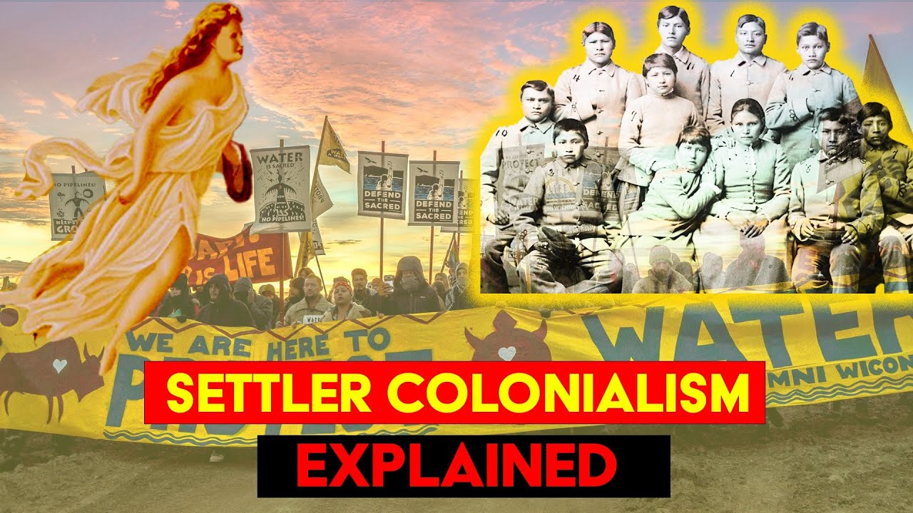
Setting context: Settler colonialism
The resources in this course are an effort to reawaken us to the truth and the story of the original inhabitants of this land. For us, it is useful to place this in the context of settler colonialism in Wabanaki homelands. But what is settler colonialism?
Total watch time: 4 ½ minutes |||||| LINK: https://www.youtube.com/watch?v=CzlRtTIR8FM

Slide 6

Setting context: Relearning & repair
This course has its roots in First Light, a collaboration between Wabanaki communities and non-native, land-focused organizations in Wabanaki homelands. First Light exists to help non-native organizations relearn histories of Wabanaki homelands, recenter Wabanaki voices in land work, and return land and restore access to Wabanaki communities. Staff from land-focused organizations across Maine have come together now for two cohorts of the First Light Learning Journey, a 12-month course on relearning, recentering, and returning. At the close of the 2021 Learning Journey, course participants asked for tools to teach their colleagues about what they learned. This curriculum is a response to this need. After we acknowledge the truth, we can begin to heal– you’ll learn more about some examples of ways First Light organizations and others are changing their practices to work towards healing in Question 6. This is long work, happening in the context of generations of contact and interaction, and promising to continue for generations to come.

Slide 7
1/30/2024

Slide 8
Question 1:
What is the history and present of Wabanaki relationships to the land now known as Maine?

Slide 9
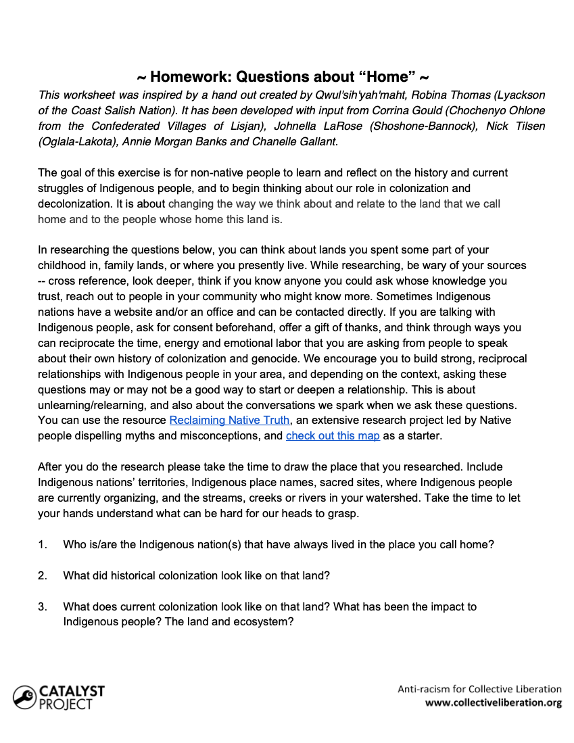
Pt 1. Homelands
Download the Catalyst Project’s Questions about Home. Take some time to try answering the questions.

Slide 10
Pt 2. Wabanaki Nations
In What’s now Maine
Cross-border ties
  The Wabanaki Confederacy is made up of multiple nations with longstanding diplomatic relationships.
  Today, four Wabanaki Nations (including two Passamaquoddy tribes) are federally recognized in the land now called Maine:
  Mi’kmaq Nation
  Houlton Band of Maliseet Indians (Wolastoq)
  Penobscot Indian Nation
  Passamaquoddy Tribe at Mohtahkomikuk
  Passamaquoddy at Sipayik
Wabanaki territories and relations extend across regions that are now divided due to international borders.
Take a moment to learn more about Wabanaki relatives in what’s now Canada, including the Abenaki First Nation at Odanak and W8linak and the Peskotomuhkati at Skutik.

Slide 11
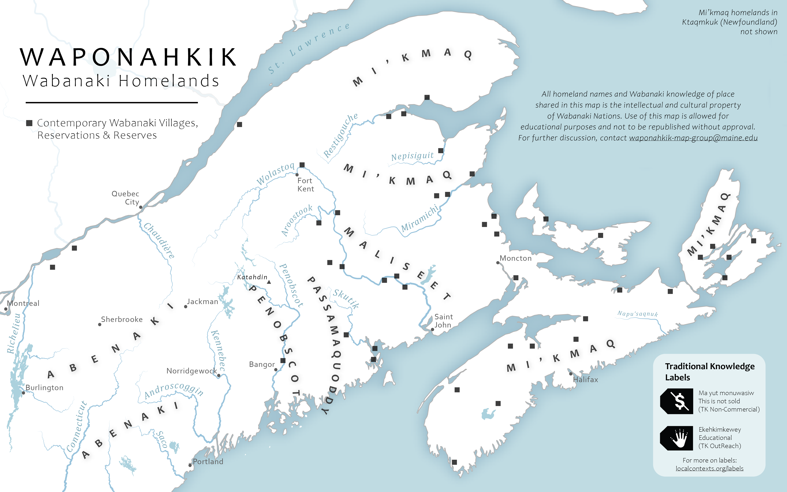
This map is one representation of Waponahkik, homeland of the people of the dawn: the lands where Abenaki, Penobscot, Passamaquoddy, Maliseet, and Mi’kmaq people live, move through, and care for, as they have for time immemorial.

Slide 12
DISCUSSION
  What questions on home could you answer before reading additional materials? What questions could you answer after reading more?
  What stood out to you most in the resources on Wabanaki Nations?
1/30/2024

Slide 13
Question 2:
Why is having a relationship to land important to Wabanaki people?

Slide 14
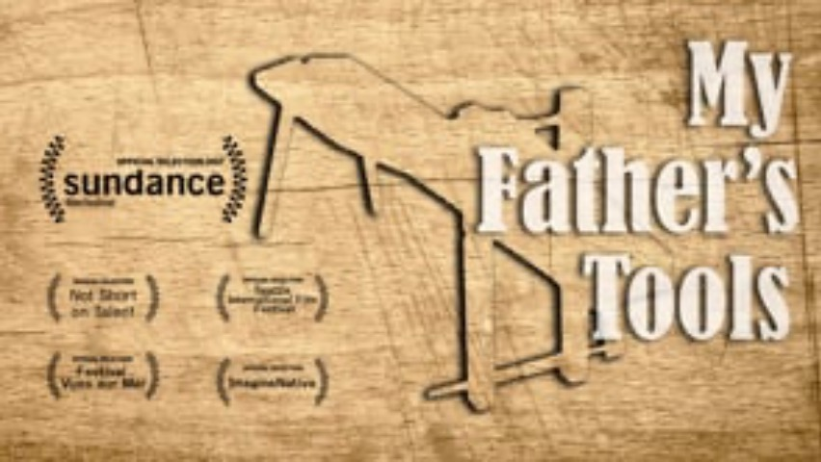
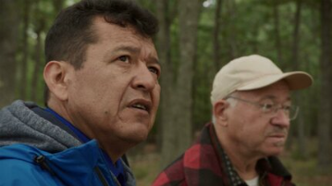
Pt 1. Land as culture
Consider how knowledge , language, and land are intertwined in this clip from PBS Native America featuring Passamaquoddy language keepers and historians, Dwayne Tomah & Donald Soctomah.
Take in the link between land and culture in the short film My Fathers Tools by Mi’kmaq filmmaker Heather Condo.
Watch time: 6 ½ Min
LINK: https://vimeo.com/244882764
Watch time: 5 ½ Min
LINK: https://www.pbs.org/video/language-protectors-zmv5ea/

Slide 15
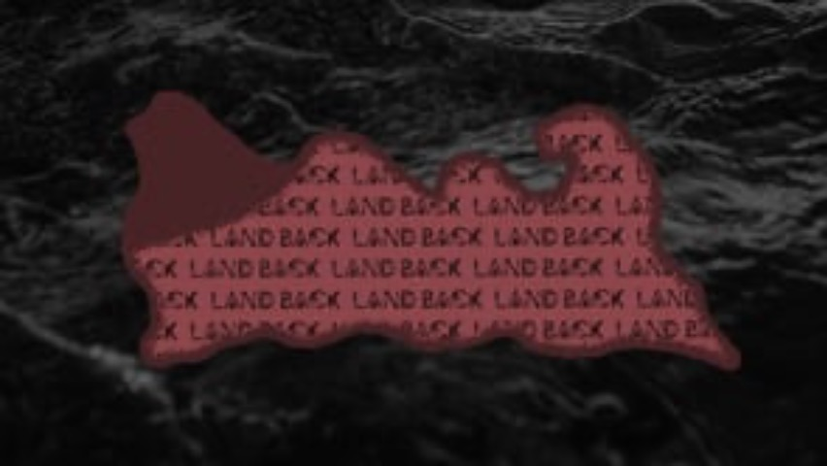
Pt 2. Land as healing
Watch Time: 20 min.||||||| DIRECT LINK: https://vimeo.com/537535470

Slide 16
Pt 3. Land as justice
Wabanaki activists describe the link between returning land and moving towards justice and sustainability in this article by Emily Weyrauch.
Consider “land and water access”, not just land: Noela Altvater demonstrates how Tribal access to clean water is a social justice issue in her work on water in Sipayik, where until recently the Passamaquoddy Tribe was not allowed to regulate their own water.

Slide 17
DISCUSSION
In what ways have Wabanaki relationships with land (and water) been severed? How does this continue today?
What is the link between land access and land relationships?
How can obstacles to Wabanaki land access be removed?
1/30/2024

Slide 18
Question 3:
What is sovereignty?

Slide 19
Pt 1. Sovereignty is inherent to Wabanaki Nations
Recent years have seen a rise in organizing and momentum around legislation in the State of Maine to recognize Tribal sovereignty. But what does sovereignty mean? Here are three meanings from Wabanaki leaders (read more here)…
Sovereignty is something that is supposed to be inherent, it’s not something that can be given or taken away. -Maria Girouard
For me, tribal sovereignty means that we have the right to explore who we want to be, without any interference from the government. -John Bear
Tribal sovereignty to me is about freedom. It is about having the opportunities to determine as a nation, as an Indigenous nation…our course and journey and direction within this complex landscape. Sovereignty allows us for that freedom, for that ability to self-determine our future. It’s our opportunity, I believe, for healing.
- Lisa Sockabasin

Slide 20
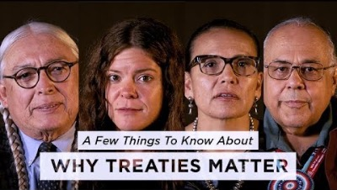
Pt 2. Native sovereignty meets colonizing forces
In Maine, recognition of inherent Wabanaki sovereignty was renegotiated during the Maine Indian Claims Settlement Act in the 1970s and 80s. This act impeded Tribal self-governance and allowed the State of Maine to block Wabanaki Tribes from federal resources. Review the summary of the settlement to understand how this legislation arose.
Treaties are agreements between sovereign nations. The U.S. federal government holds treaties with many Tribal Nations but continually fails to uphold recognition of Tribal sovereignty.
Watch time: 5 ½ min.||| DIRECT LINK: https://www.youtube.com/watch?v=bexvE4lZRGo

Slide 21
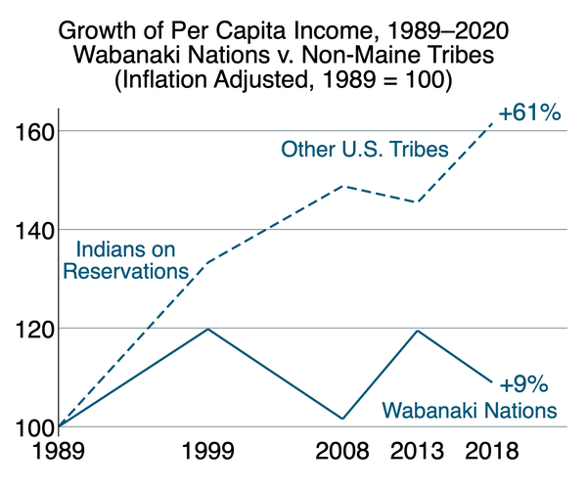
Pt 3. Implications of unrecognized sovereignty
Ever since the legislative process in the 1970s and 80s, Wabanaki people have recognized the problems in Maine’s Wabanaki legislation. Wabanaki sovereignty is inherent, and legislation must match that reality. Take a deep dive into the problems in the settlement act and how they relate to sovereignty through Ambassador Crofton-Macdonald’s analysis Wolastoquey Ambassador Crofton-Macdonald's analysis.
Recent research documents the economic implications of three decades of limiting Wabanaki sovereignty.

Slide 22
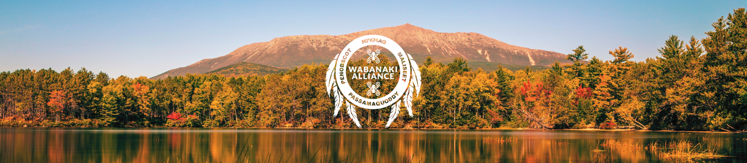
Pt 4. Ongoing efforts to formally recognize Wabanaki sovereignty
Wabanaki Tribes continue to organize for legislation that recognizes their inherent sovereignty in Maine. The Wabanaki Alliance is leading sovereignty efforts: see Tribal leaders' statement on 1626 , one of the recent legislative attempts to address problems in the settlement, and explore the Wabanaki Alliance website for ongoing updates. Non-native allies can take direction from the Wabanaki Alliance and organize to support Tribal Sovereignty: for example, review Recognize Tribal Sovereignty, a statement written by conservation organizations and edited by the Wabanaki Alliance.
“[Sovereignty] can be ignored or not recognized or chipped away at and that’s what I fear every time we put something new in front of the legislature. I fear that we’re giving them an opportunity to chip away at our sovereignty.”
- Maria Girouard, Penobscot historian

Slide 23
DISCUSSION
How did these readings challenge what your previous ideas of sovereignty for Wabanaki Tribes?
How do you understand sovereignty now?
Do you see a link between land-focused organizations and sovereignty?
1/30/2024

Slide 24
Question 4:
In what ways is our organization perpetuating harm?

Slide 25
Pt 1. Our organizations and land
Conservation practices and worldviews are intertwined with colonialism, in history and in ways that continue today. Dive into this podcast to understand the history of this movement in the United States, as well as how it continues internationally, today: Upstream Podcast episode on Decolonizing Conservation
Typically, conservation organizations operate under the intention to protect land from development or extraction. To do this, they often hold land or easements that control land uses. In her article for Wabanaki REACH, Erica Buswell describes how that “good intention” can be harmful to Wabanaki communities.
Even when organizations attempt to return land to Indigenous communities, they can continue to hold onto control – as revealed in this article about land return to Kashia and Esselen Tribes by Peggy Berryhill.

Slide 26
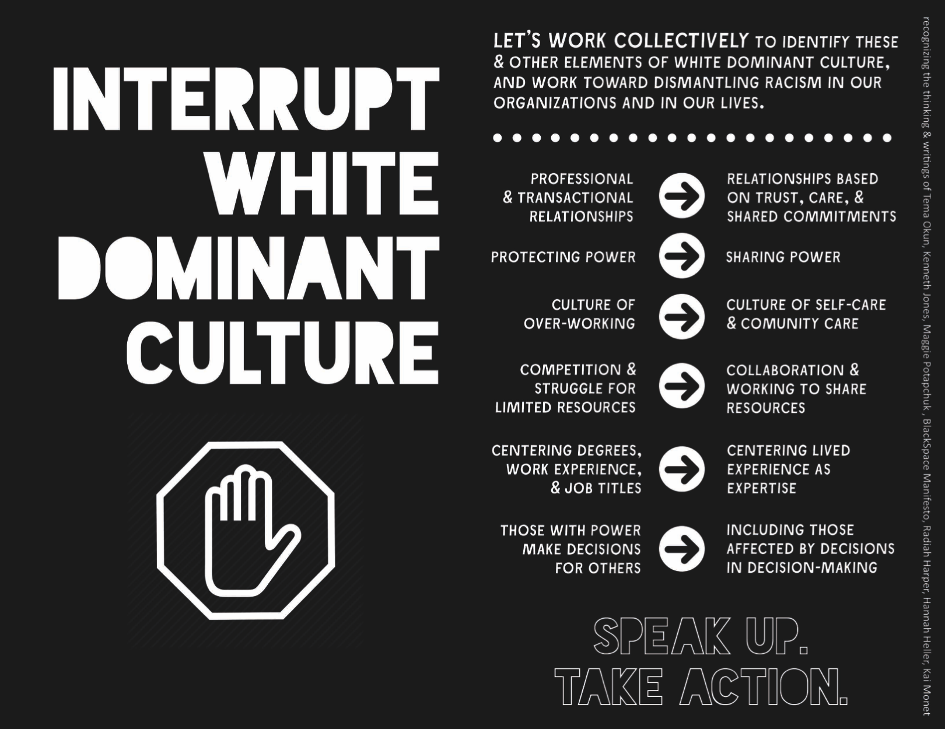
Pt 2. Our organizational culture
Our organizations aren’t “neutral” spaces, but spaces often shaped by dominant white culture.
Spend some time with Tema Okun’s detailed page on White Supremacy Culture Characteristics and Community Centric Fundraising’s critique of the non-profit industrial complex.
Credit: Mike muranski, 2019

Slide 27
DISCUSSION
What characteristics do you recognize in your organization?
What antidotes do you already identify with?
What does it take for a landholding organization to overcome the legacy of competition and hoarding so it can share resources and technical expertise with others?
1/30/2024

Slide 28
Question 5:
How can we grow past harmful narratives in our land work?

Slide 29
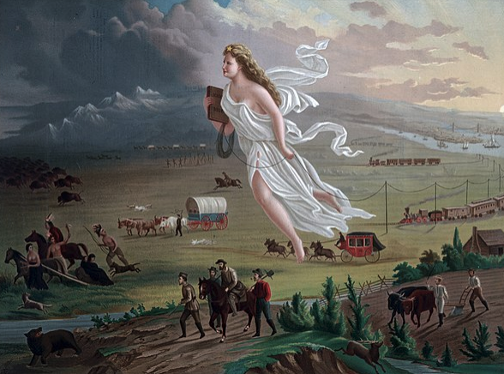
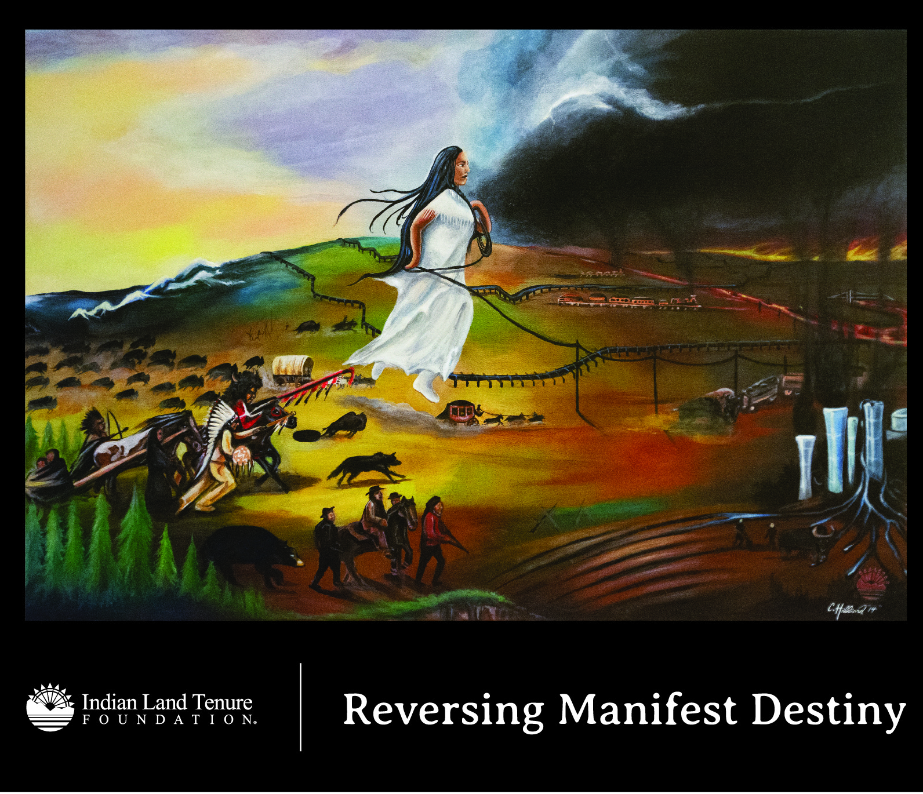
Pt 1. Harmful stories can underlie conservation work
American Progress – John Gast - 1872
Reversing Manifest Destiny – Charles Hilliard - 2021
Stories about land often erase (see Mali Obomsawin’s The Myth of Native American Extinction Harms Everyone) or romanticize (see Angelo Villagomez’s White Savior and Noble Savage Tropes) Native communities.
Narratives can be visual, too. What stories do these two paintings tell about land and Native peoples in North America?

Slide 30
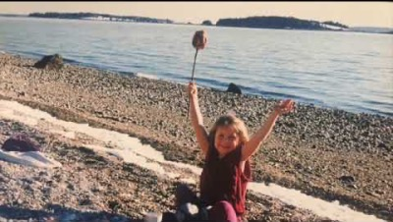
Pt 2. Conservation signs still tell stories of erasure
Watch this interview with Ann Pollard Ranco to understand one experience of encountering a sign on Native land that perpetuates an erasure narrative.
Watch Time: 45 min.||| Direct Link: https://dawnlandreturn.org/first-light/updates/sign-speaks-volumes-islands-and-erasure-narratives

Slide 31
Pt 3. Changing narratives
Land acknowledgements offer a chance to counter erasure, but sometimes are symbolic narratives that don’t compel real action.
Listen to this 2020 episode of Dawnland Signals to hear Maria Girouard, Esther Anne, Darren Ranco, and Diane Oltarzewski in conversation on land acknowledgements.
For work with Wabanaki land access, it’s important to remember that storytelling and relationship are deeply intertwined. Review these learnings from a Sunlight Media Collective + First Light workshop on changing narratives, and consider: what is the underlying reason behind the story your organization is telling? Who benefits? Who is at the center?
Listen time: 54 min

Slide 32
DISCUSSION
Where does your organization share narratives about its work with Wabanaki communities? (E.g. funding proposals, reserve signage, press releases, teaching programs, land acknowledgements?) What narratives do you see in these?
What changes could your organization make to reflect more on its storytelling?
1/30/2024

Slide 33
Question 6:
How are organizations with relationships to land showing up in new ways?

Slide 34
Pt 1. Organizations can show up for Native-led efforts
Native leadership has created space for non-native organizations to contribute to various projects. Here are a few examples from Wabanaki homelands:
Monitoring and preventing the spread of Emerald Ash Borer, and ensuring ongoing access to ash for Wabanaki people: Ash Protection Collaboration Across Waponahkik
Advocacy networks to help support the push for Wabanaki Sovereignty and other policy priorities: Wabanaki Alliance Coalition
Tribal, State, Federal, and organizational partnerships for widescale restoration projects: Penobscot River restoration (2004 – 2016)
(Note: These are just a sampling of examples. What other cases do you know of?)

Slide 35
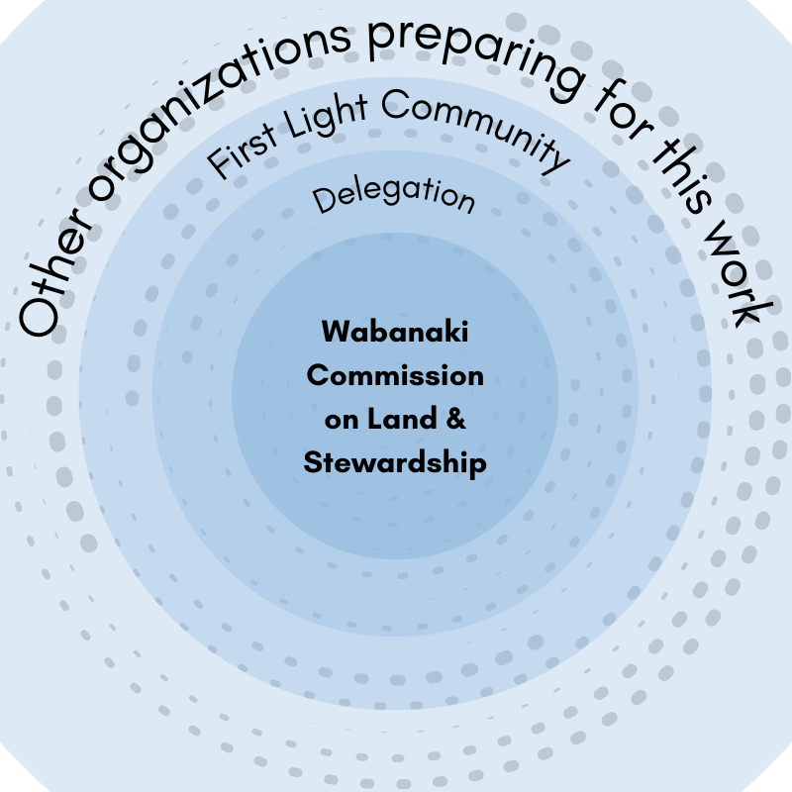
Pt 2. Organizations can work together to offer collective solidarity
In Maine, non-native organizations have made a commitment to return land and resources to Wabanaki communities through their involvement with First Light. The guiding belief of First Light is that we can do more to return land and resources when we work together than we work individually. Towards this future, First Light organizations are…
Listening to guidance from the Wabanaki Commission on Land and Stewardship, the intertribal body (seated since 2020)
Contributing financial resources to the Wabanaki Self-Determination Fund (provisional name; launched 2022)
Coming together to return Kuwesuwi Monihq to the Passamaquoddy (2021)
The Wabanaki Commission is at the center of the First Light community efforts.

Slide 36
Pt 3. Organizations can make individual changes to commit to this work
Organizations in Maine are learning how to navigate perceived legal barriers that impede land return, including taking a look at dissolution clauses and sharing benefit with Wabanaki people.
Partners at the Oregon Land Justice Project created a guiding document on where and how bylaws/organizational policies can shift to support Indigenous communities.
Land in Common is a community land trust guided by reparation and decolonization, and they practice in line with their values in their ongoing Call for Land for BIPOC communities across what’s now Maine.
TNC Maine crafted organizational commitments with Wabanaki partners to clarify how they will work in support of Wabanaki solidarity.
Northeast Organic Farming Association of VT edited their board compensation and childcare policies to reduce the barriers to serving as a leader of their organization.

Slide 37
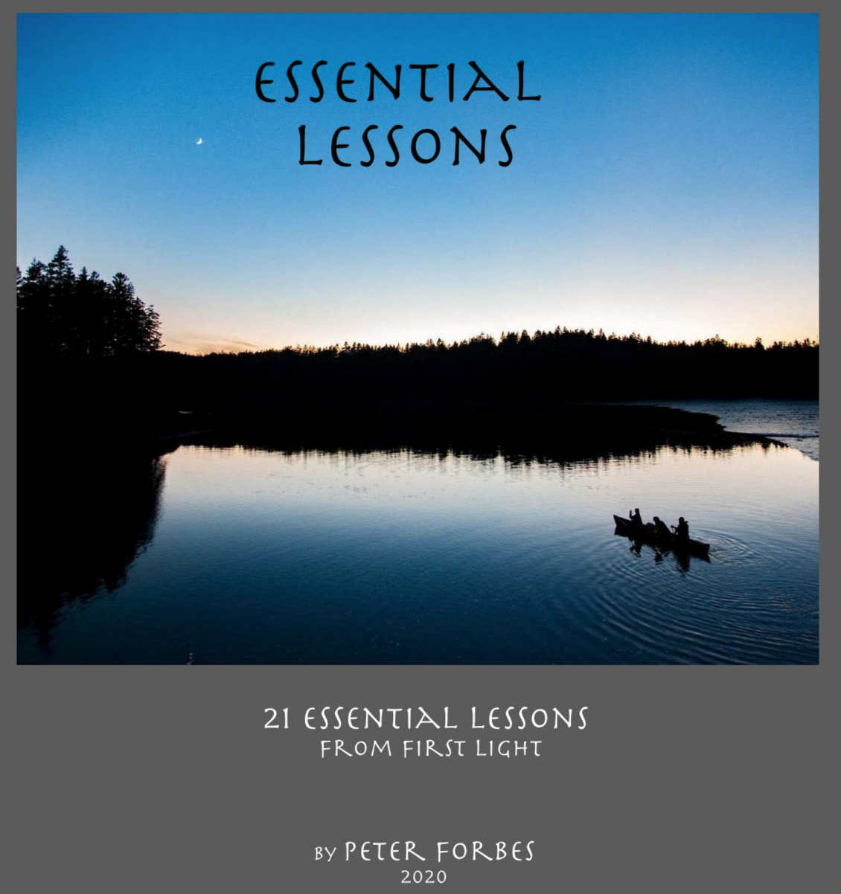
Pt 4. Organizations can create space for ongoing learning and reflection
This is ongoing work. Intentionally creating space for new learning and self-reflection about our organizations can interrupt inertia and help continue the process of evolving.
In addition to creating space for reflection in your own organization, consider linking up with other organizations to build relationships and further the learning and action by getting involved with First Light.
For an example of self-reflection from the conservation world, take a look at Essential Lessons by Peter Forbes for First Light or Shifting to a Culture of Decolonization in Conservation Communities by Erica Buswell for Wabanaki REACH.

Slide 38
DISCUSSION
What could our organization reasonably do to share resources, skills, time?
What is holding you back?
1/30/2024

Slide 39
Question 7:
How can we expand our vision of possible futures?

Slide 40
Pt 1. Native-led groups are already doing the work to restore land relationships
In multiple places across Turtle Island (North America), Native-led groups are developing ways for settlers to return financial resources: for example, the Manna-Hatta, Sogorea Te’ Land Trust & Shummi Land Tax and Real Rent Duwamish invite non-Native people to acknowledge theft of land, and begin to work in response through redistributing financial resources.
Closer to home, the Wabanaki Commission on Land and Stewardship is developing an intertribal voice for communicating with conservation communities around land priorities.
Closer to home, the first Native-led land trust in Wabanaki homelands is stewarding land, growing food, and creating community space: Bomazeen Land Trust
(Note: These are just a sampling of examples. What other cases do you know of?)

Slide 41
Pt 2. Broad-reaching resource return is possible
Returning National Parks to the Tribes is an idea gaining momentum in the U.S., and it’s already starting to happen in other nations
Wealth-holders are committing half of their income to reparations
Sometimes, the actions we can take now are a bridge to the future we want to see…
  For example, in Virginia, Rappahannock leadership and conservation organizations co-write about leaning on collaboration between Tribes and nonprofits while state and federal law evolves to support Tribal sovereignty

Slide 42
Pt 3. Reconciliation offers the opportunity to think differently
Through working towards reconciliation, we have the opportunity to develop relationships and practices that go beyond settler conceptions of land and ownership and work. For example…
  “Conservation” can expand beyond ideas of protecting a narrow definition of land or species– what about conservation to protect a song?
  Truth and reconciliation are intrinsically intertwined with storytelling, teaching, and cultural revitalization, as described in this work around Temagami’s Bear Island Canoe House.
  Close to home, the Kinship Collective is challenging settler colonial thinking by turning towards creative work and asking questions from the Penobscot River: dive in in this short video.
Watch Time: 3 min.

Slide 43
DISCUSSION
What examples are you most inspired by?
Do you think any of these examples felt impossible when they were first imagined? How did they become possible?
How does your own organization fit into this vision for the future? How can you help these futures unfold?
1/30/2024

Slide 44
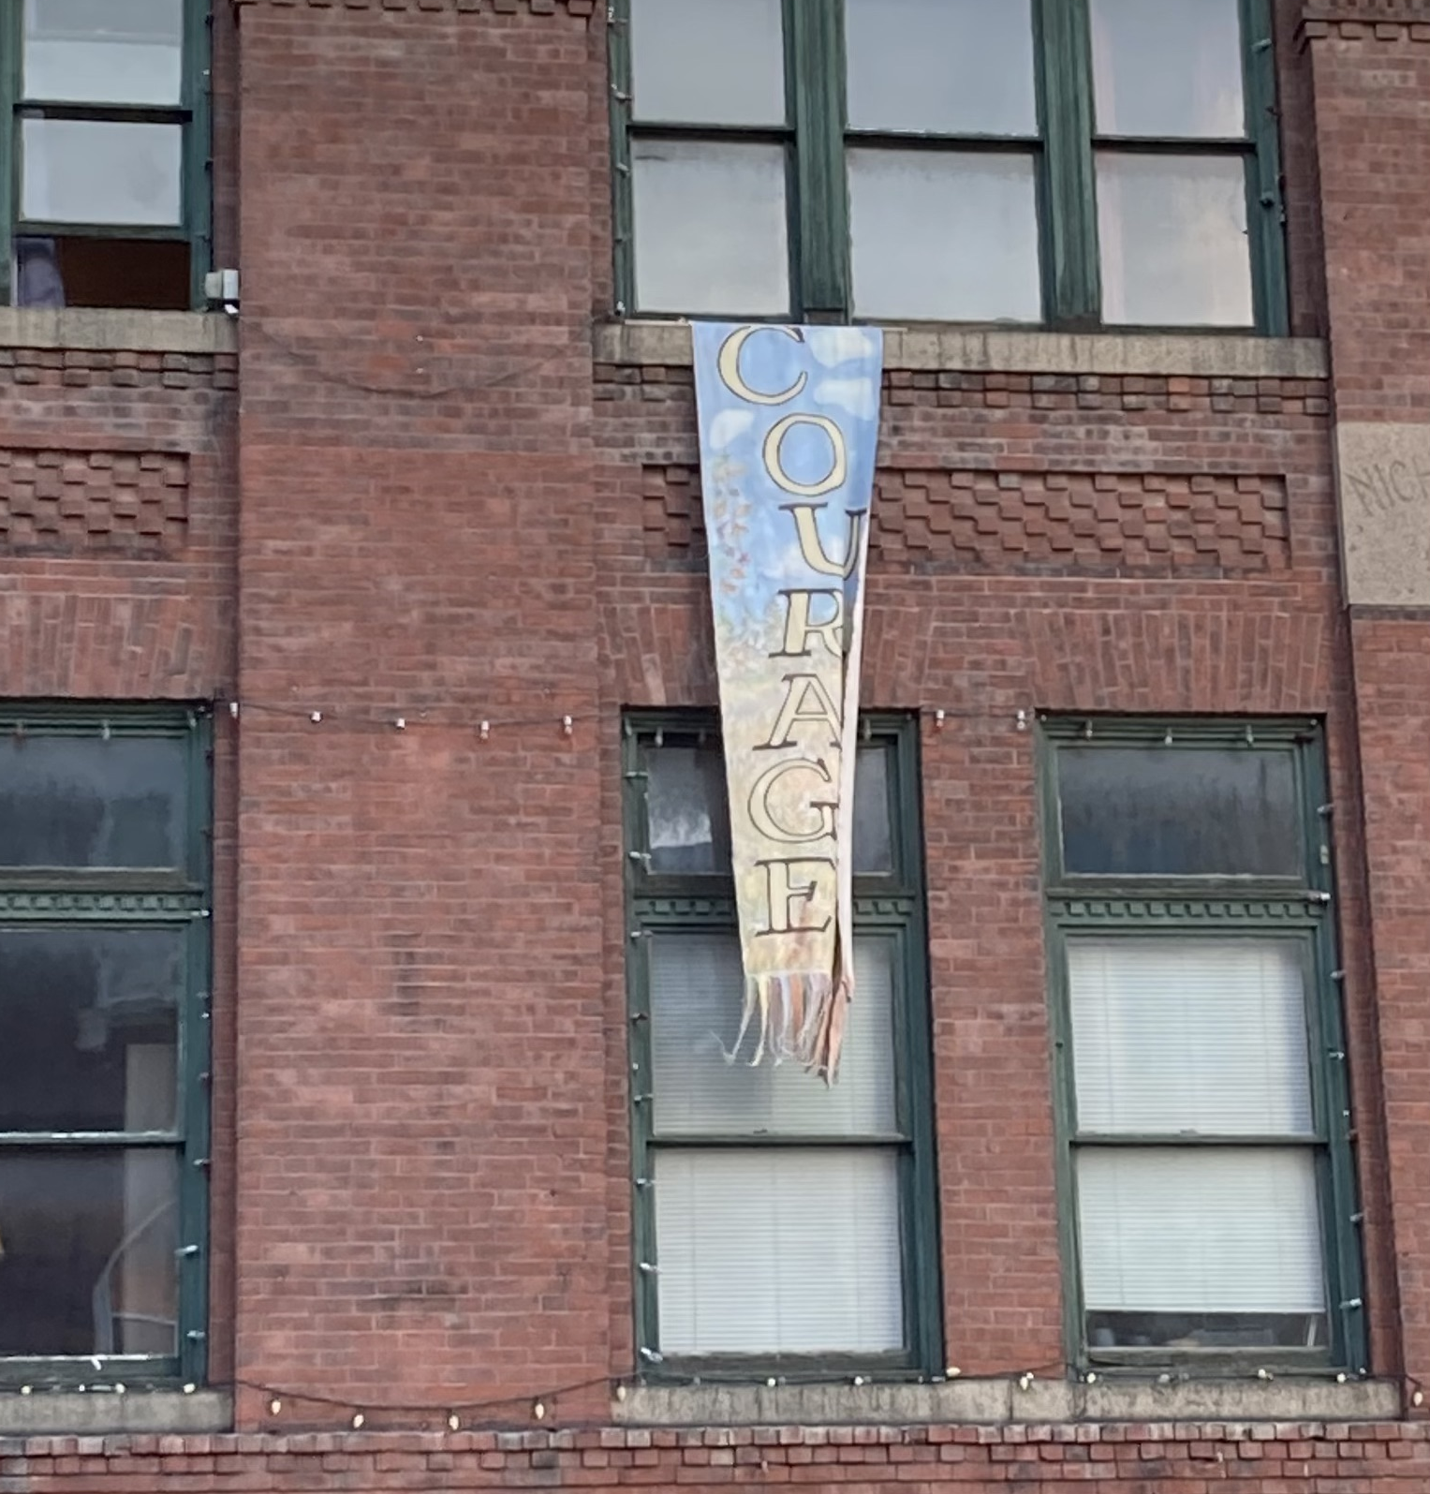
Thank you.
Thank you for your work in this course. We hope the questions, materials, and discussions introduced you to new ideas and important challenges in the work to share resources and power and land with Wabanaki communities.
This is a living document, and we hope you will reach out with any suggestions to make this curriculum stronger. Please contact Ellie Oldach (ellie@firstlightmaine.org) or Ella McDonald (e.mcd224@gmail.com) with any questions or comments about this curriculum. We’d truly be glad to hear from you.
Original First Light Logo created by ann Pollard-Ranco
Credit: Peter forbes– an Image from first Light summit 2022

